Slide 1

Slide 1
Superstore Profitability Analysis
By:
Ammar, Sadiq, Noora, Eman, Latifa

Slide 2


Slide 3
STATS - Customers
1,590 Customers with Majority of 51% for Consumer Segment
3

Slide 3
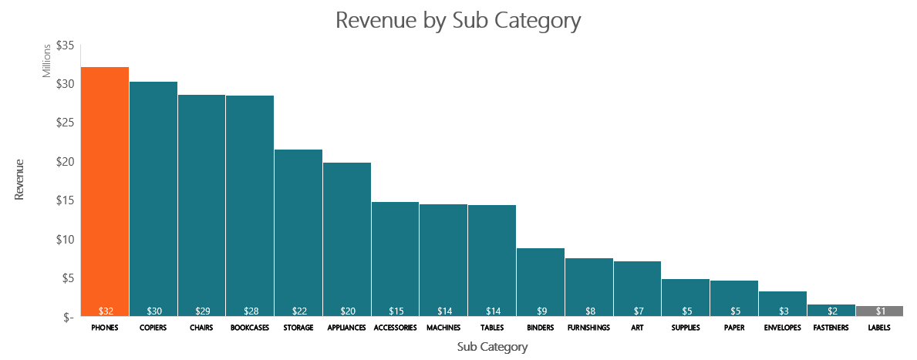
STATS - PRODUCTS
Highest Revenue is by Phones with 32M+
Lowest Revenue is by Labels with 1M+

Slide 4

Slide 3
STATS - PRODUCTS
Tables as Sub-Category recorded loss of 59K+
However, products sold in the same order covered 77% of the loss
3

Slide 5
Slide 3
STATS - PRODUCTS
In opposite, Binders as Sub-Category recorded the Highest profit by 91K+
And Labels as Sub-Category recorded the Highest profit margin by 1.4%
3

Slide 6





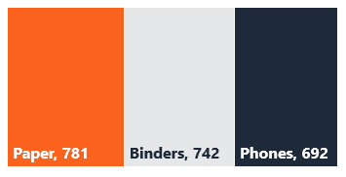
DASHBOARD - PRODUCTS
10,292
17
Products
Sub Categories
Most Expensive
Average Unit Price: $83.97
Value of products: $864,299
Category (Technology)
Top Products in Sub Categories
Number of Products in each Category
$328,733
Sub Category (Tables)
5,689
$107,534
Office Supplies
Product (Motorola Smart Phone)
$5,337
2, 375
Technology
2,228
Furniture

Slide 7


DASHBOARD - SALES
966,545
$243,464,752
Total Orders
Total Revenue
Top 3 Products Revenue
Average Qty per Order: 3 Units
Average Revenue per Order: $251.89
Apple Smart Phone
Revenue by Category
$1,824,596
Revenue by Segment
Canon imageCLASS 2200
$91M+
$1,743,695
$123M+
Technology
Consumer
Cisco Smart Phone
$1,713,726
43M+
73M+
Office Supplies
Corporate
78.8M+
45M+
Furniture
Home Office

Slide 8







Slide 4
KPI – KEY PERFORMANCE INDICATORS
Sales
Cost
Profit
Higher
Lower
Higher
4

Slide 9
Slide 4
KPI – KEY PERFORMANCE INDICATORS
Profitability
Limitation:
Superstore datasets did not provide the details of cost to measure the impact of cost change on profitability
Assumption:
We assumed the profit on the orders is the Gross Profit(GP), therefore we can get the GP and by subtracting sales from profit we get the cost
1.Gross Profit (GP) = Sales – COS (Cost of Sales)
2. Profit Margin= (GP / Sales) x 100
4

Slide 10


ANALYSIS - REVENUE
Superstore experienced rapid Revenue Growth in 2016.
In 2017 onwards, Superstore sales continue to increase, but at a slower rate
Retail business average growth rate of 4.7 % in U.S.
Find the resource - Ceicdata

Slide 11
ANALYSIS - REVENUE
Shake-out of Revenue Growth rate, usually due to either
approaching market saturation; or
entry of new competitors in the market

Slide 12
Slide 4
KPI – KEY PERFORMANCE INDICATORS
In 2019, Revenue of Low Margin products exceeded $120M
While High Margin products dropped to $9.8M
4
Note: Higher Margin >= 1.25%
Note: Lower Margin < 1.25%

Slide 13
Slide 4
KPI – KEY PERFORMANCE INDICATORS
If lower-margin revenue have increased while higher-margin sales have decreased, then that could explain the falling profit
4

Slide 14

Slide 4
KPI – KEY PERFORMANCE INDICATORS
Over the years the cost still higher and reduced the profit margin
0.43% is a risky margin and will always rely on volume of revenue to be profitable and secure the cash

Slide 15
Slide 4
KPI – KEY PERFORMANCE INDICATORS
99.57% is a risky cost margin and will always rely on volume of revenue to secure the cash and pay for purchases

Slide 16
Slide 4
Findings and Recommendations
Findings | Recommendations
cost of goods sold (COGS) may be increasing at a faster rate than sales | Focus on improving gross margins by reducing COGS through better procurement practices or negotiating better prices with suppliers
Mix of Sales between High and Low Margin profits on products
Superstore may be invested heavily in promotion or marketing to support customers' retention and conversion | Apply additional service charges to the suppliers such as: Rebate Fee Shelf Rental Fee Marketing and Promotion Fee
4

Slide 17
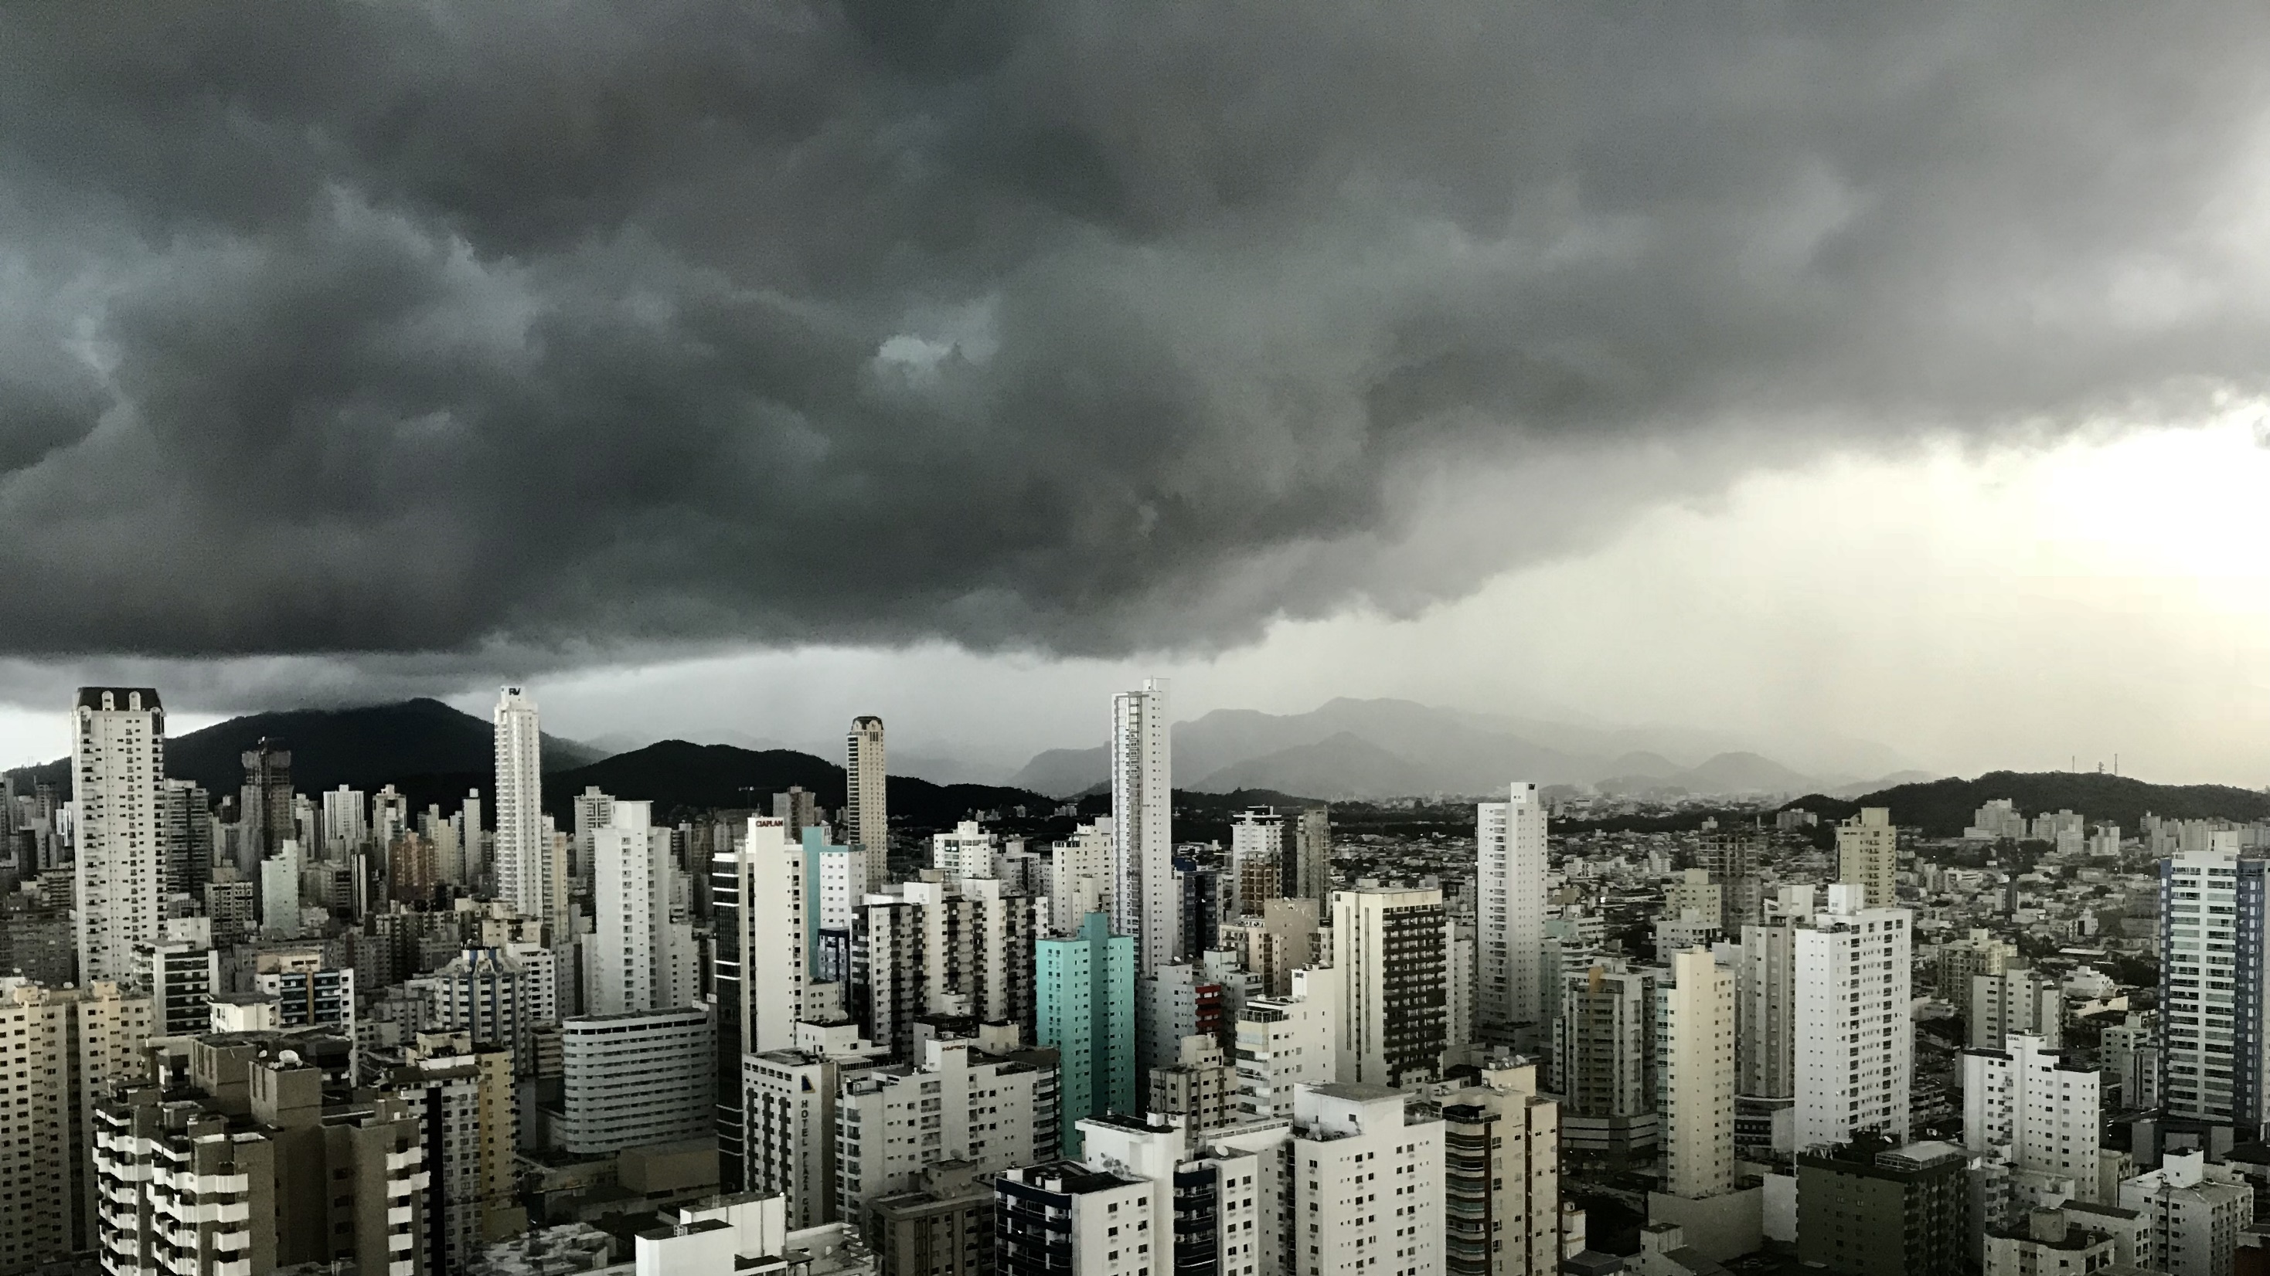
Slide 11
Questions Time

Slide 18
Slide 11
THANK YOU !

